Slide 1
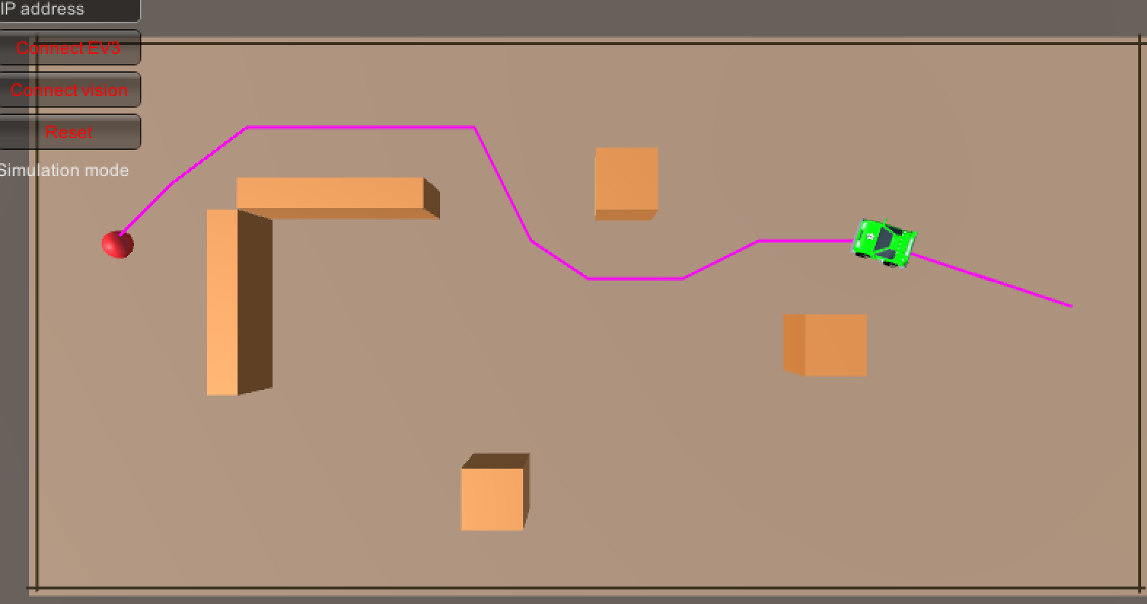
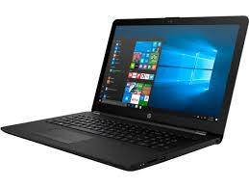



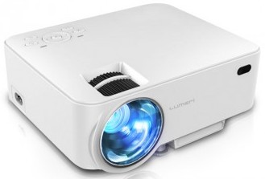
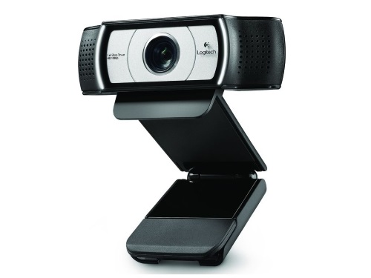
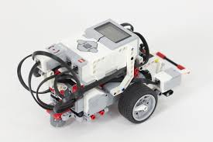

laptop running Unity and openCV
position and orientation of markers
Beamer displaying the Unity scene on the Playground on the floor
move commands
sensor data
Camera overviewing the playground
Playground with EV3’s with ArUco marker

